Slide 1

Number Plate Recognition Using YOLOv5
GUIDE NAME: STUDENT REGISTER NO AND NAME:
Mrs. S. Abiramasundari 225003074-Kakumani Lakshmi Priya
AP-I/CSE 225003105-Narreddy Pranathi Maha Shiva
225003201-C Amirtha

Slide 2
CONTENTS
Base Paper Details
Problem Statement
Objectives
Literature Review
Work Plan
Work Flow
Architecture Diagram
Model Architecture
Dataset Description

Slide 3
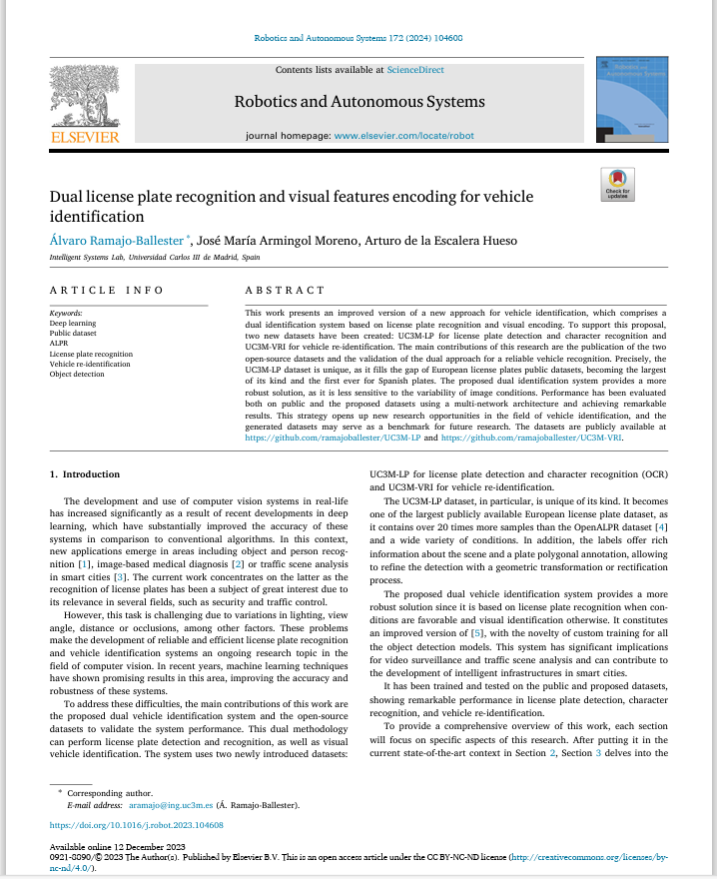
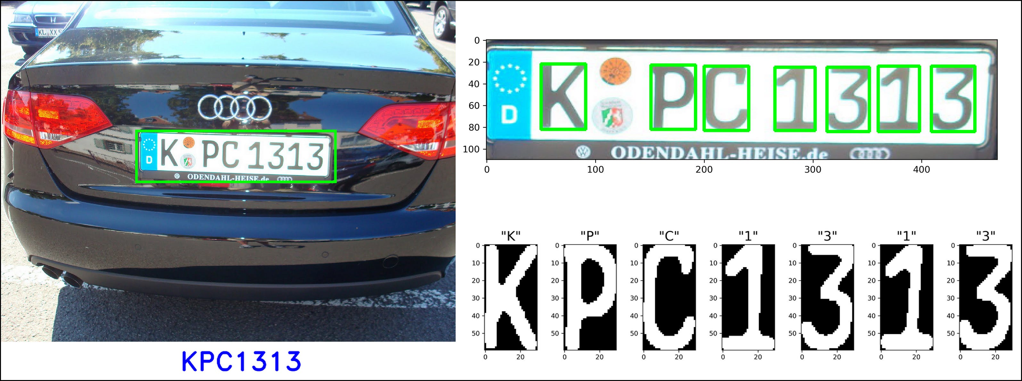
BASE PAPER DETAILS

Slide 4
PROBLEM STATEMENT
Overcoming obstacles like great distances and diverse climatic conditions is essential to the efficient operation of Number Plate Recognition technology, particularly in unfavourable circumstances like fog
Plate recognition becomes more challenging when visibility is limited, highlighting the need for creative solutions. In this conditions by using deep learning techniques number plates are recognized accurately

Slide 5
OBJECTIVE
To develop and implement an advanced system that can accurately and reliably identify license plates on vehicles, particularly when they are at significant distances from the surveillance cameras.
LPR is used to detect vehicles, precisely locating and defining license plate bounding boxes using the YOLOv5 model
Optical Character Recognition (OCR) is applied to detect, classify, and organize each character, forming a unique identification number
In foggy conditions, we utilize the Dark Channel Prior algorithm to dehaze images, enhancing visibility.

Slide 6
LITERATURE REVIEW
S.NO | TITLE | AUTHOR | YEAR | JOURNAL | DESCRIPTION | MERITS | DEMERITS
1 | Research on Vehicle Detection and Recognition Technology Based on Artificial Intelligence | Bo Yang | 2023 | IEEE Access | This approach proposes an Artificial Intelligence Vehicle Detection and Recognition Technology based on SVM algorithm | High Recognition Rate Providing important guidance for transportation industry | Unidentifiable cases and stability concerns. Restricted to some weather conditions
2 | Vehicle Detection and Recognition | Sriashika Addala | 2020 | Research Gate | Using advanced Technology to automatically detect vehicles and read their license plates. Techniques used: Hough transformation Artificial Neural Networks | Improved efficiency Reduced manual efforts in traffic surveillance systems | Need for further validation and testing of the proposed technique in real worlds traffic scenarios

Slide 7
S.NO | TITLE | AUTHOR | YEAR | JOURNAL | DESCRIPTION | MERITS | DEMERITS
3 | Vision-Based Vehicle Detection and Counting System Using Deep Learning in Highway Scenes | Huanshen Song Zhe Dai Xu Yun | 2019 | European Transport Research | This system uses cameras to detect and count vehicles on highways. By dividing the road into sections and using advanced algorithms the system can track vehicles and provide valuable traffic information | It presents a novel vision-based system for vehicle detection and counting in highway scenes | The system processing time may increase with a greater no of vehicles, potentially leading to longer processing times
4 | Research on Vehicle Identification Method based on Computer Vision | Zhou Yan Yuan Deming Zhou Jun | 2019 | Research Gate | The base paper discusses a method for identifying vehicles using computer vision. It focuses on using a Machine Learning algorithm called AdaBoost and specific visual features called Haar-like features to recognize vehicles on road | Offers high detection accuracy and low false alarm rates, making it valuable for enhancing vehicle safety | Only focuses on identifying vehicles under certain illumination conditions

Slide 8
S.NO | TITLE | AUTHOR | YEAR | JOURNAL | DESCRIPTION | MERITS | DEMERITS
5 | Vehicle Detection and Classification via YOLVOv8 and Deep Belief Network | AI Mudawi Abdelhaq Algarni | 2023 | MDPI | An article discuss a new method for detecting and classifying vehicles in aerial Images using advanced technology like YOLOv8 and Deep Belief Network | Innovative technology can bring both complexity and advancement The model can accurately identify vehicles of different sizes | Complexity can hinder efficiency and understanding
6 | Research on Vehicle Detection Algorithm Based on Improved YOLOv4 | Mingzhi Xu Jing Xu | 2022 | IOPscience | Incorporates the K-means++ clustering algorithm for obtaining suitable anchor frame coordinates | Higher accuracy and stability in vehicle detection through the use of an improved advanced techniques | Limitations in scalability , computational complexity

Slide 9
S.NO | TITLE | AUTHOR | YEAR | JOURNAL | DESCRIPTION | MERITS | DEMERITS
7 | Vehicle Identification and Location Detection at CCTV to find Vehicles Using OCR and OpenCV | V. Shiva Kumar N.Pravalika | 2023 | International Journal of Research Publication | Implementation of OCR and OpenCV techniques to extract license plate information from CCTV footage, enabling vehicle identification and location detection | Enhancing security measures and law enforcement capabilities | It lacks specific details on experimental setup, performance evaluation metrices
8 | Research on Deep Learning Automatic Vehicle Recognition Algorithm Based on RES-YOLO Model | Yanyi Li Jian Wang Jin Huang | 2023 | MDPI | The study includes details on network structures , data enhancement techniques, and experimental results demonstrating robust performance in various challenges scenarios and implementing a RES-YOLO Model for Vehicle Recognition | Presents an innovative and robust approach that outperforms traditional YOLO networks | Face challenges related to overfitting , training errors, requiring careful adjustment of coefficients to prevent these issues

Slide 10
WORK PLAN
Work | 0-10 Days | 10-20 Days | 20-35 days | 35-45days | 45-50 days
Dataset Collection
Data Preprocessing
Model Architecture
Model Selection and Training
Model Testing

Slide 11
WORK FLOW DIAGRAM
Input Images
Foggy Images
Data Preprocessing
Dehaze images
(DCP)
Model Training and Validating
Testing
Extract Number Plate Characters
Detecting Bounding Box
Apply OCR

Slide 12
ARCHITECTURE DIAGRAM
Data Preprocessing
Data Splitting
Models
Dataset(Images)
Train
Validate
Resizing
yolov5n
Annotations for the input images
yolov5s
yolov5m
Foggy Images
Dark Channel Prior Algorithm
Recognizing Number Plate Characters
Apply OCR
Detecting Bounding box
Testing images
Based on accuracy Selecting model
Model Training

Slide 13
YOLOv5 consists of three parts: 1)Backbone: CSPDarknet(Cross Stage Partial) 2) Neck: PANet(Path Aggreration Network) 3) Head: Yolo Layer BACKBONE : 1.In YOLOv5 Convolutional Neural Networks are used as the backbone architecture for object detection. 2.Here CSPDarknet53 backbone is to extract hierarchical features from input images, enabling the model to detect objects.
YOLOv5 ARCHITECTURE

Slide 14
NECK: 1)The neck facilitates the fusion of features from different scales, enabling the model to create a more comprehensive representation of the input image. 2) PANet helps to aggregate multi-scale features from different stages of the backbone network, enabling the model to better handle objects of various sizes. HEAD: 1) YOLOv5 employs a detection head that predicts bounding boxes, objectness scores, and class probabilities. It uses anchor boxes to predict the size and position of bounding boxes. 2)It uses anchor boxes to predict the size and position of bounding boxes. 3)Anchor boxes are predefined bounding box shapes used during training in object detection models. During training, these boxes are adjusted by the model to better match the actual objects in the dataset. The model learns to predict bounding box coordinates, objectness scores, and class probabilities.
YOLOv5 ARCHITECTURE

Slide 15
YOLOv5 models are classified based on their sizes: 1)YOLOv5n(Nano) : YOLOv5n is a smaller variant aimed at ultra-lightweight applications or scenarios with extremely limited computational resources. 2)YOLOv5s(Small): Faster inference speed but may struggle with detecting smaller objects 3)YOLOv5m(Medium) : Good balance between speed and accuracy
MODELS USED

Slide 16
OCR(Optical Character Recognition): OCR systems are widely used to extract text from images, making it possible to analyze, edit, and search for information within them
1)Image Detection: object detection on a frame using the provided model
2)Bounding Box Plotting: plot bounding boxes and recognition results on the frame
3) License Plate Recognition: recognize license plate numbers using EasyOCR
4)Text Filtering : filter out wrongly detected text regions

Slide 17
DCP(Dark Channel Prior Algorithm): The Dark Channel Prior (DCP) algorithm is a widely used method for single image dehazing. It is based on the observation that the dark channel of a haze-free image, which is the minimum intensity value across the RGB channels, contains important information about the scene.
The Dark Channel Prior (DCP) algorithm for image dehazing, which involves the following key steps:
Dark Channel Calculation: The dark channel algorithm first computes the minimum intensity value among the three color channels for each pixel, and then applies morphological erosion to find the minimum value within each local patch
Atmospheric Light Estimation: The atmospheric light is estimated using the dark channel by selecting the minimum intensity values from a specified percentage of the image pixels

Slide 18
Transmission Map Estimation: The transmission map is estimated based on the atmospheric light and the dark channel.The transmission map is initialized as a matrix of ones and adjusted using the dark channel to refine the haze removal process.
Dehazing:The dehazed image is generated by utilizing the input image, transmission map, and atmospheric light.The dehazing process involves correcting the image using the estimated transmission map and atmospheric light to enhance visibility and reduce haze effects.

Slide 19
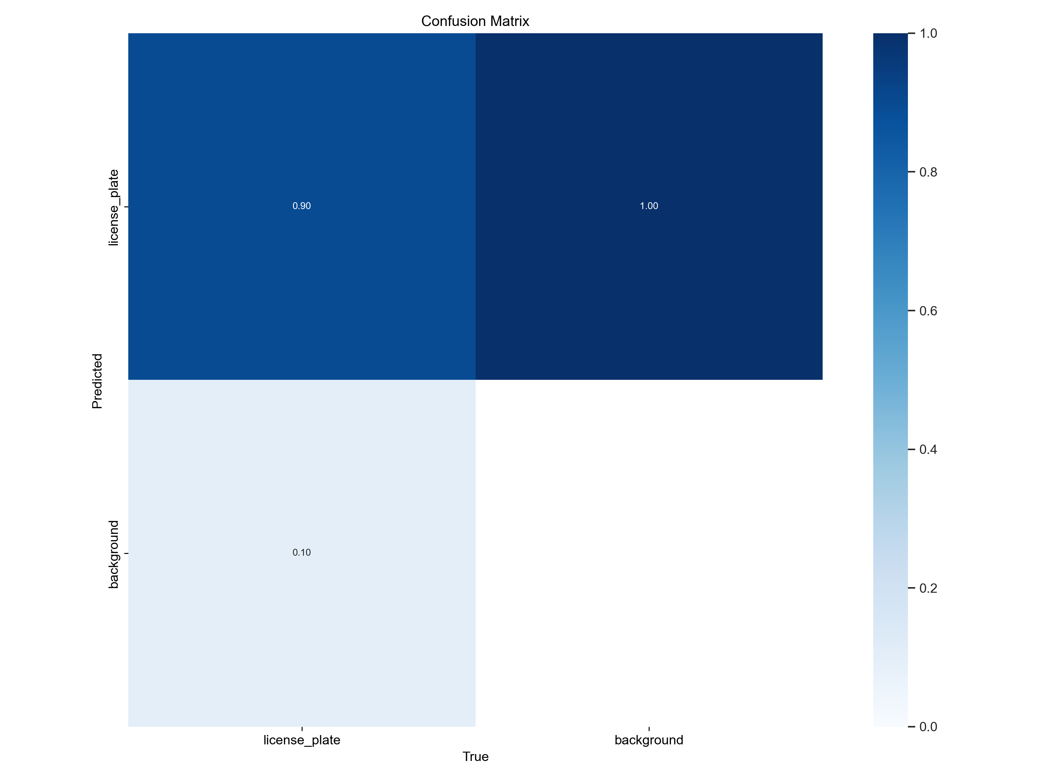
ACCURACY :
YOLOv5n
YOLOv5s

Slide 20

ACCURACY :
YOLOv5m
The accuracy of YOLOv5n,YOLOv5s are 90%
The accuracy of YOLOv5m is 94%

Slide 21
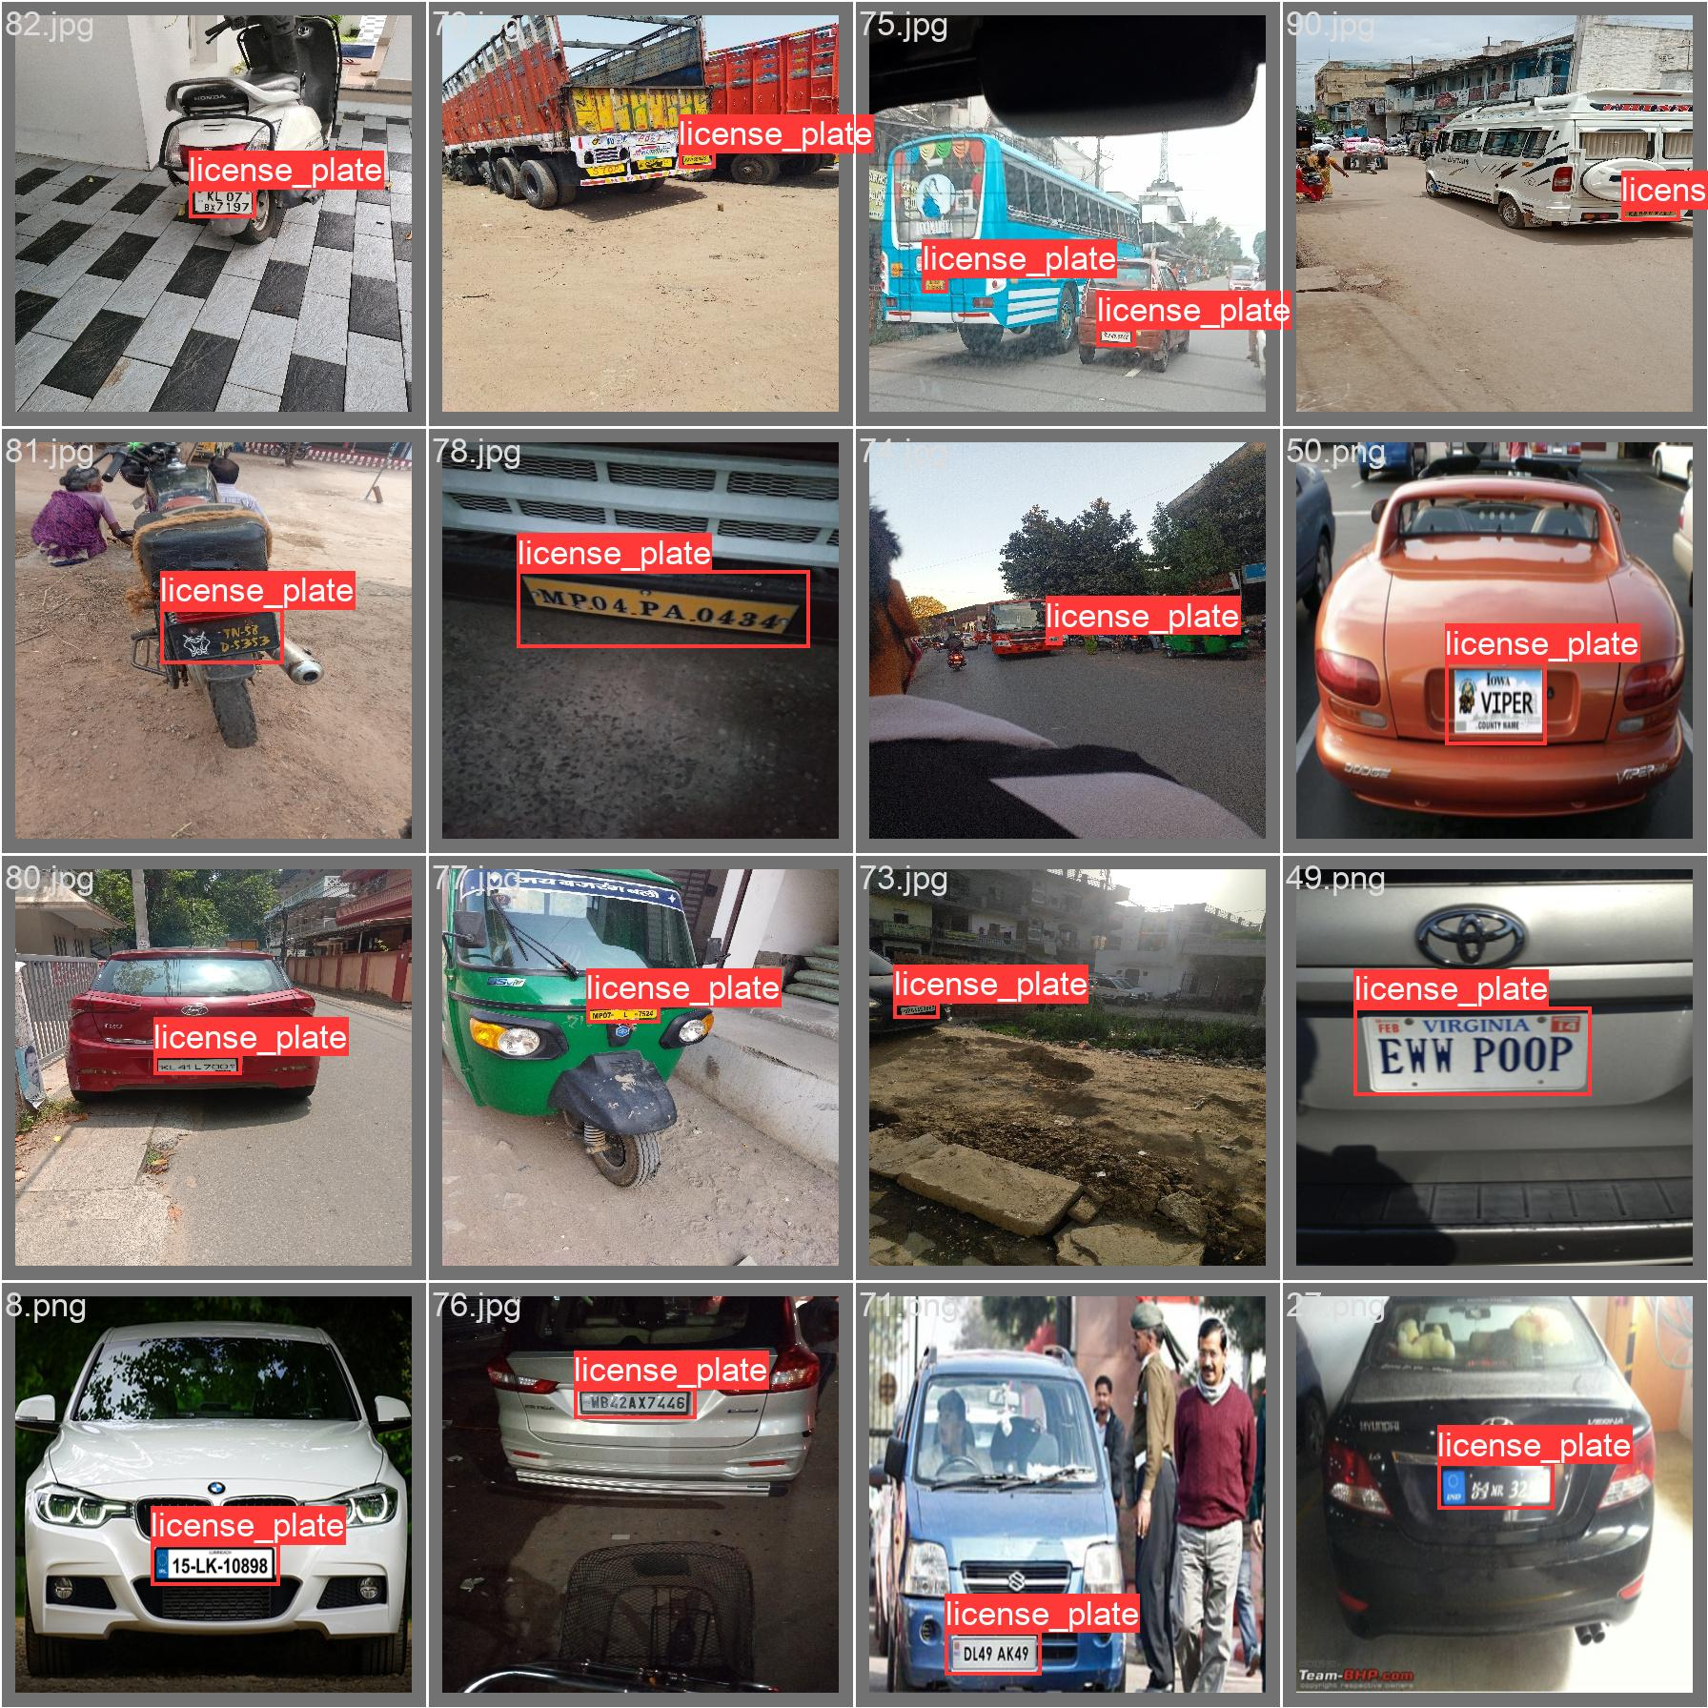
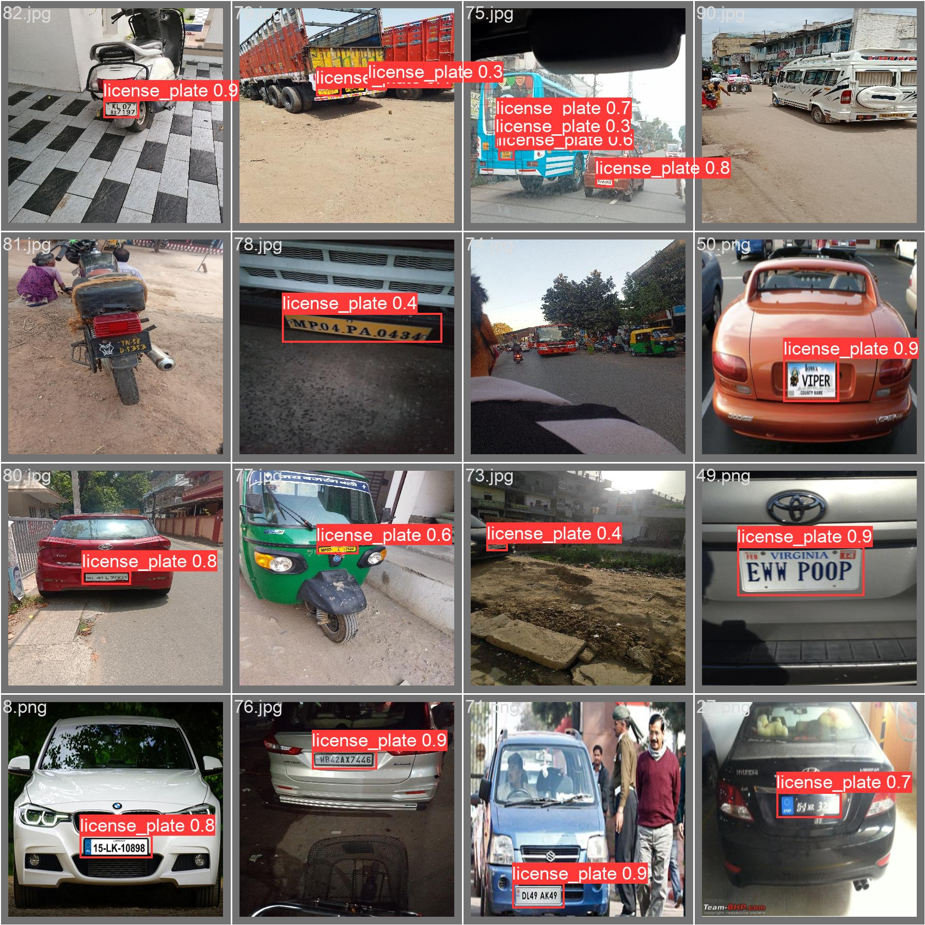

Slide 22
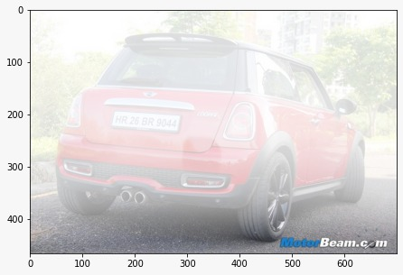
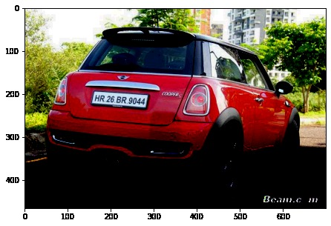
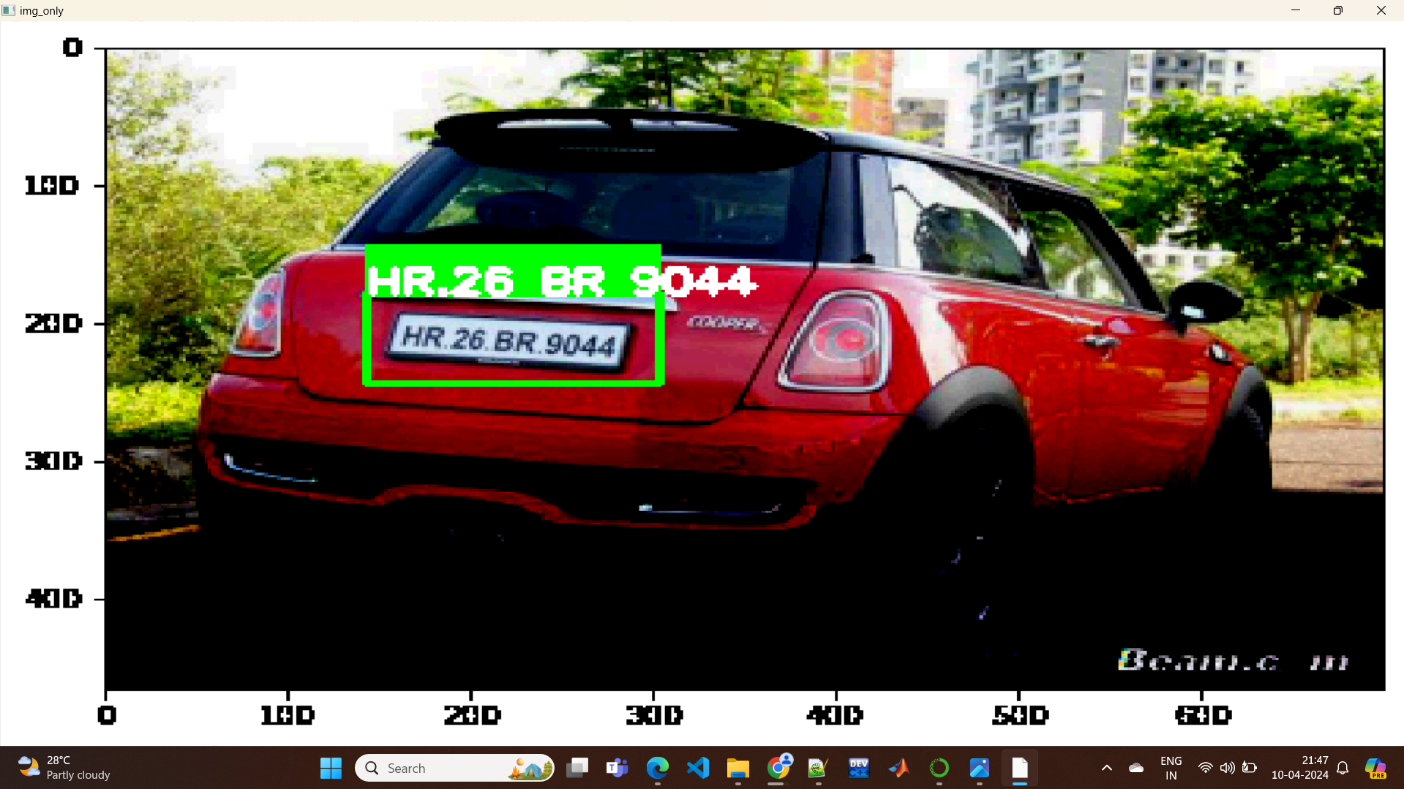

Slide 23
The datsets is likely sourced from “KAGGLE”: 1)https://www.kaggle.com/datasets/andrewmvd/car-plate-detection This dataset contains 433 images This dataset contains completely car images. 2)For dehazing foggy images has been chosen from different sources
Dataset Description

Slide 24
THANK YOU!!

